Slide 1



Music Machine Learning
V – Bayesian inference
Master ATIAM - Informatique
Philippe Esling (esling@ircam.fr)
Maître de conférences – UPMC
Equipe représentations musicales (IRCAM, Paris)

Slide 2
Learning
Using machine learning to model creativity ?
Supervised learning is inferring a function from labeled training data
Unsupervised learning is trying to find hidden structure in unlabeled data
We can define any problem as
So we first need to define what function could approximate this process
Then we need to evaluate the « quality » of this approximation
Problem space
Solution space
How can we model uncertain (or creative) problems ?

Slide 3
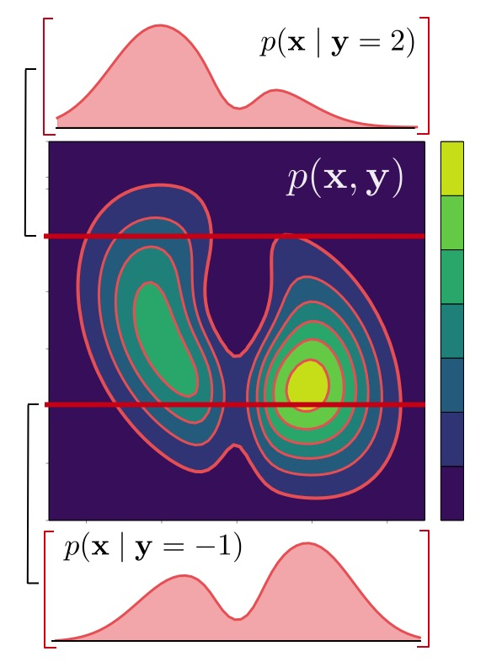


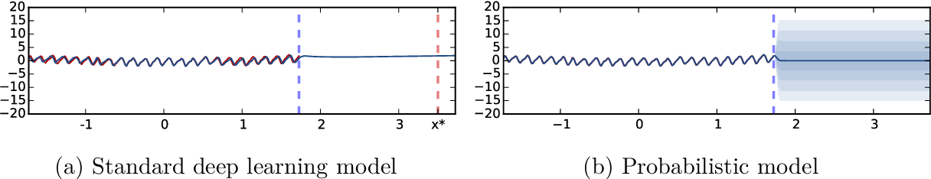
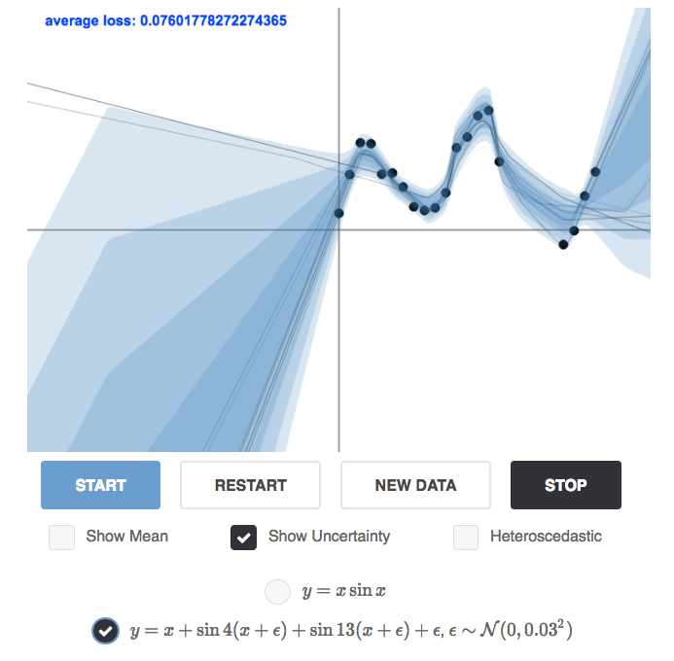
Probabilistic machine learning
Consider data
following a distribution
Sampling new individuals
Now how to define (discriminative) learning ?
Looking for the answer given the input
Why ?
Handling uncertainty

Slide 4
2. Conditional probability
Definition:
= class
= evidence
Let’s say we have a classification problem in which
Easy
Hard

Slide 5
Bayes’ rule
Definition:
= class
Bayes’ rule
= evidence
Let’s say we have a classification problem in which
Easy
Hard
Bayes’ rule

Slide 6
Bayesian classification
Now starting from Bayes’ rule
I have several classes, I have to decide given some evidence
If I have the probability of the evidence given each class
And the a priori probability of each class
Then I’m done … as the denominator is the same for all classes
But usually there is more than one piece of evidence
So what if these pieces of evidence are independent (given the class)
So we just need to go through every class and select the biggest one

Slide 7
Bayesian classification
Let’s say I have two coins, one is fair and one is rigged
Heads
Tails
Heads
0.8
0.2
0.8
0.5
0.16
0.128
0.5
0.5
0.5
0.5
0.25
0.125

Slide 8
Bayesian inference
Make inferences about unknown quantities using available information.
Inference = make probability statements
Unknowns = parameters, functions of parameters, states or latent variables, “future” outcomes, classes labels
Information = data-based / non data-based
theories of behavior and “subjective views”
there is an underlying structure
parameters are finite or in some range

Slide 9
Bayesian inference
Likelihood function, probability of the data given the model
Prior probability, the probability of the model on previous knowledge
Posterior probability, the probability of the model (class) given the data
Probability of the data, normalizing constant ensuring the probabilities sum to 1
Posterior ∝ “Likelihood” × Prior
Likelihood contains all information relevant for inference.
Same likelihood function = same inferences about unknowns.
Bayesian Inference = Find the explanation with highest posterior probability

Slide 10
Bayesian inference
Goal is to represent the belief of learning agents
Bayesian inference of classes can be interpreted as
Update the prior beliefs with a new information x
Priors are usually unknown
Can be removed by assuming equal belief in all models at the start
Posterior is prior influenced by the likelihood according to new evidence (information)
Likelihood
Prior
Posterior
Evidence ( )

Slide 11
Bayesian inference
How to choose the best class given the data?
Choose the Maximum A Posteriori (MAP) class
Intuitive: Choose the most probable class given the observation(s)
We do not know
But we know
If we apply Bayes’ rule in
We obtain
We have a similar denominator ( ) for all
So we need to solve for

Slide 12
Bayesian inference
Class 1
Class 1
Class 0
Class 0
1
1
1
1
1
1
1
1
1
1
1
1
0
0
0
0
0
0
0
0
0
0
0
From a priori
To a posteriori
0
(nb. X axis has no meaning here)
Intuitively

Slide 13
Bayesian inference
Class 1
Class 0
What do we need to lay a Bayesian inference ?
(A priori) class probabilities
Without other knowledge an equal belief
Class-conditionnal probabilities
Here the class depends on the noise added by the channel
By the central limit theorem we can assume that noise is Gaussian

Slide 14
Bayesian inference
Gaussian probability density function
Since we assumed that the noise is Gaussian and additive
So X corresponds to the input (Y) plus Gaussian noise
Probability of input given classes
Class 0
Class 1
Real-world
Pick 0
Pick 1

Slide 15
Bayesian inference
What happens for the general case
To compute the Bayesian Decision Rule (BDR), we can use log probabilities
And note that the priors are equal for everybody so
If we develop this equation

Slide 16
Bayesian decision theory
If we consider that both distributions have the same variance
So the optimal decision will be
All this work to find this … but we did find back the intuition
And we had to make lots of assumptions
Uniform class probabilities, additive noise, gaussianity

Slide 17
Bayesian decision rule
Let’s pump up the BDR for multivariate Gaussian
covariance
Thanks to the log the BDR becomes
So the final BDR is
The optimal rule is to assign x to the closest class
Mesured with the Mahalanobis distance (d)
To which a constant is added to account for class prior

Slide 18
Summary of BDR
The Bayesian Decision Rule is the optimal one
The models reflect a causal interpretation of the problem
Natural decomposition of the problem into
« what we knew » (prior)
« what the data tells us » (observation)
No need for heuristics to combine these two informations
However BDR optimal only if models are correct
How do we estimate the parameters of our distribution ?

Slide 19
Maximum Likelihood
So we have the optimal (and geometric) solution
But we still don’t know the parameters
We have to estimate these values from a training set
(ex. use the average value as estimate for the mean)
We rely on the Maximum Likelihood (ML) principle
Choose a parametric model for probabilities (function of parameters)
Assemble a training dataset
Find the parameters that maximize the probabilities

Slide 20
Maximum Likelihood
Choose a parametric model for all probabilities
We usually denote parameters by and the class-conditional distributions by
is not a random variable but a parameter (probabilities are function of it)
Assemble a collection of datasets
Set of examples independently drawn from class i (cf. sampling schemes)
Select the parameters that maximize the probability of data (for that i)
How do we solve this ?

Slide 21
Maximum Likelihood

Slide 22
Maximum Likelihood

Slide 23
Maximum Likelihood
Summary of Maximum Likelihood
Choose a parametric model for probabilities
Assemble a dataset of independent examples
Select parameters that maximize the probability of the data
Given the dataset, we need to solve
The solutions are the parameters such that

Slide 24
Frequentist vs. Bayesian
But wait … why not using Bayes to estimate the parameters ?!
In fact we can ! There is just a difference in interpretation
Frequentist (ML) view
Probabilities are relative frequencies
Makes sense with lot of observations
But in most cases we do not have lots of observations
And the probabilities are mostly not objective
Bayesian view
Probabilities are subjective (not equal to relative count)
Probabilities are degrees of belief on the outcome
Equates to « frequentist over alternative realities »

Slide 25
Frequentist vs. Bayesian
Optimal estimate
Under ML there is one « best » estimate (optimization-wise)
Under Bayes there is no « best » estimate
In the probabilistic framework, « best » has no real sense
Predictions
We do not really care about the parameters themselves
Only in the fact that they build models …
Models can be used to make predictions
Unlike ML, Bayes uses all information in training to predict

Slide 26
Example
Communications problem
Two states
Y = 0 : transmit signal
Y = 1 : transmit signal
Noise model

Slide 27
Example
Calibration mode
Ask the system to transmit a single class and measure X
Compute the ML estimate of the mean of X
Result: the estimate is different than
We need to combine two forms of information
Our prior was
Our data-driven estimate is
We could stop there but think about erratic jitter on one calibration

Slide 28
Bayesian solution
Gaussian likelihood (observations)
The calibration data we receive
The mean we estimated from it
Gaussian prior (what we knew)
The mean we used up to now
are known hyper-parameters
We need to compute the posterior distribution for
The « real » (optimal) mean we will use afterwards

Slide 29
Conjugate prior
We should sweat over the mathematics … but note that
The prior is Gaussian
The posterior is Gaussian
Whenever the posterior is in the same family as the prior
is a conjugate prior for the likelihood
Posterior is the reproducing density
A number of likelihoods have conjugate priors
And development of posterior is straightforward

